Slide 1



Power BI Pricing & Licensing

Slide 2

Factors to consider
The licensing model to go is determined by the following three factors:
Cost
Number of users (creators, viewers, occasional viewers) – not very sure
Features required – embedding feature(not sure with the other features)
Note: We can recommend licensing only after having a discovery call, like we did for ACC.
info@snp.com
203.287.9114

Slide 3
Assumptions and Recommendations
Assumptions
Share Power BI report with users who do not have Power BI accounts
Embed Power BI report inside your custom application
Recommendations
Based on the observations, SNP Recommends Power BI Embedded​ License along with Power BI Pro for developers
info@snp.com
203.287.9114

Slide 4
Power BI Versions
Power BI Desktop (Free)
Power BI Pro
Power BI Embedded
Power BI Premium
info@snp.com
203.287.9114

Slide 5
Power BI Pro vs PBI Embedded
Features | Power BI Pro | Power BI Embedded
Can embed in external apps? | Only for development and testing | yes
Can publish to PBI Service? | Yes | No
Needs a web developer? | No | Yes
Limitation on embed tokens? | Yes | No
Use Case | For development and testing embedded report | To move to production
PBI Report Builder? | No | For A4 SKU and Above
Billing? | Monthly | Hourly
Commitment? | Monthly Commitment | No Commitment
info@snp.com
203.287.9114

Slide 6
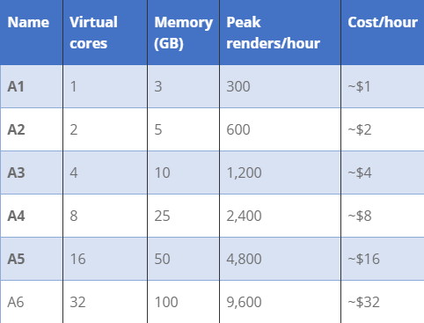
Power BI Embedded Pricing
It is a Power BI Premium feature that enables you to embed Power BI workspaces and dashboards within a web page or an app & offers three different SKUs. This licensing plan is based on page renders and its hourly
Power BI Embedded A SKU
SKU’s are purchased through Azure
Allows to embed Power BI reports in your applications through dedicated capacity
A great feature for customers is A SKUs can be paused when not required to save costs
info@snp.com
203.287.9114

Slide 7
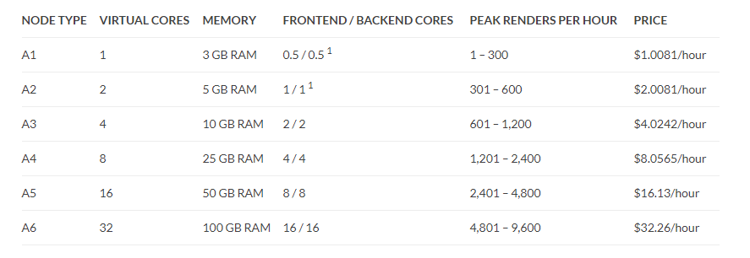
PBI Embedded Pricing Details
info@snp.com
203.287.9114

Slide 8
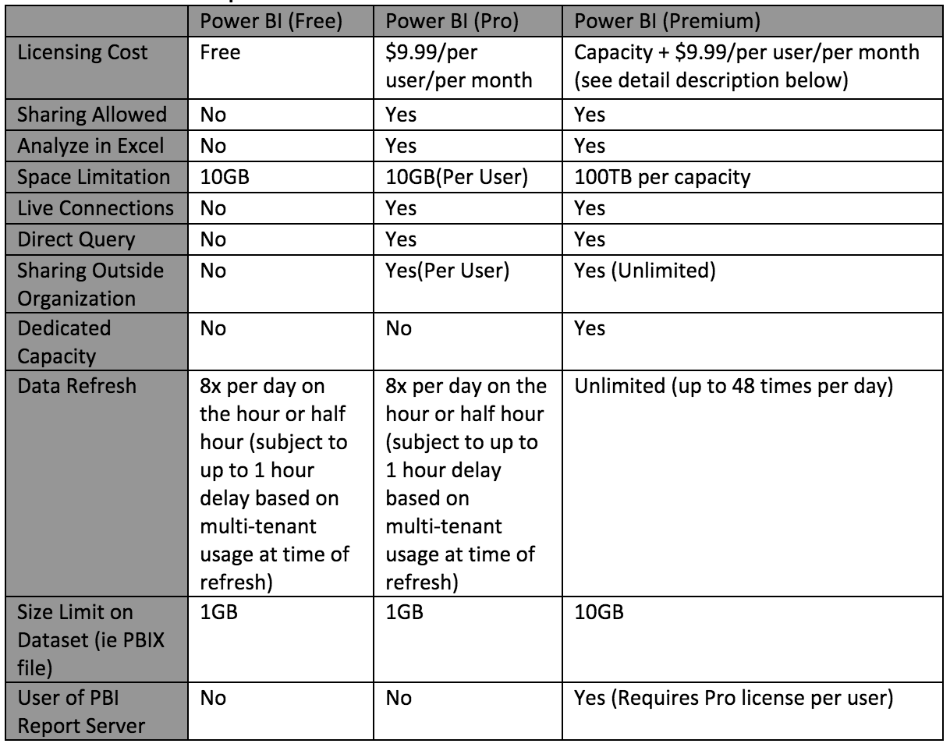
Power BI Pricing
info@snp.com
203.287.9114

Slide 9
Power BI Versions
 | Power BI Free | Pro | Embedded | Premium
Analyze in Excel | No | Yes | No | No
Embed into custom application (Power BI embedded) | No | For development testing | Yes | Yes
Refresh Frequency |  | 8 times a day |  | 48 times a day
Power BI Report builder | No | No | Yes ( with A4 licensing option) | Yes
Report Server | No | No | No | Yes
Space Allocation | 1GB | 10GB |  | 100TB
info@snp.com
203.287.9114

Slide 10
Power BI Embedded Advantages
Power BI Embedded is the reporting and analysis solution for mobile and web applications. Power BI Embedded is an Azure service that integrates Power BI solution into mobile and web applications. Using API Keys of Power BI workspace and embedding Power BI report frame into the web/mobile application it will be integrated into the application.
Key Advantages:
Integrating Power BI into web and mobile applications
Application users don’t need Power BI account to view the report (App owns data model).
User can authenticate to the application with customer own authentication system and then can pass the user roles to Power BI for RLS.
Security integration with the application.
info@snp.com
203.287.9114

Slide 11
Power BI Embedded Security
The new Embed option for Power BI reports, that can easily and securely embed reports in internal web portals. These portals can be cloud-based or hosted on-premises, such as SharePoint 2019. Embedded reports respect all item permissions and data security through row-level security (RLS). They provide no-code embedding into any portal that accepts a URL or iFrame.
Key Advantages:
1. Apply User & Role to an embed token
2. Secure embed code
3. Granting Report Access
4. Customize embed experience using URL settings (pageName & Url filters)
info@snp.com
203.287.9114
Notes:
The Embed option supports URL filters and URL settings. It allows you to integrate with portals using a low-code approach requiring only basic HTML and JavaScript knowledge.

Slide 12
Power BI Governance
Establish a secure, reliable Governance framework with Power BI platform that meets the current and enable future growth
Security
Monitoring & Auditing
Data Restrictions and Sharing
Data Security
Workspace Security
Tenant Level Privileges/Security
User-Level Security Privileges
Azure Active Directory Security
Reports & Dashboard security /Access privileges
Usage metrics
Audit logs
Policies to meet regulatory compliance and records management
Establish policies for Power BI Activity logs and Office 365 activity logs to analyze usage for all Power BI resources
Enabling Protection metrics
Publishing & Sharing reports across the organization & outside
Data Protection Metrics Reports
Define Sensitive Label policies and data & report encryption policies
Cloud App security policy controls
info@snp.com
203.287.9114
Notes:
q458t

Slide 13
Power BI Desktop & Report Builder
 | Power BI Desktop | Power BI Report Builder
Description | Microsoft Power BI is a new age business intelligence technology used for dealing with data and creating reports. It is user-friendly software with easy-to-use features for creating, publishing and sharing reports. | Power BI Report Builder aka (Paginated Reports) which is also a Microsoft’s product. A new authoring tool for paginated reports in Power BI, separated from SQL Server Reporting Services Report Builder, but specifically optimize for publishing to the Power BI Service.
Benefits | PBI is user-friendly and easy-to-use tool for report creation and data analysis. It is rich in graphical capabilities ( Drill-down, drill through, navigation etc..) | PBIRB does not have much to offer in the area of graphics. Rather, it has a good drill-down capacity.
Accessibility | PBI software can access on three different kinds of platforms; web, mobile devices (apps) and desktop. | PBIRB can access on the web and on the desktop.
Usage | More user-friendly due to its rich graphical user interface and drag-and-drop capabilities. | Less user-friendly as it focuses more on a coding/programming interface.
Data Dependency | In PBI, you can work with both structured and unstructured data. | In PBIRB, you can work with structured and semi-structured data but not unstructured data.
info@snp.com
203.287.9114

Slide 14
Power BI Desktop & Report Builder
 | Power BI Desktop | Power BI Report Builder
Components | Microsoft Power BI is a cloud-enabled SaaS. Also, it is an open-source HTML 5 enabled platform for data analysis. | Power BI Report Server is a server-based enterprise report generation and visualization tool.
Training | Power BI is easy to learn as it uses a graphically rich user interface with drag-and-drop features to create a report. Really don’t have to engage with the technical and coding part of the process which makes it a user-friendly tool that can be learned by a user of any skillset. | Need to have a technical background to learn SSRS. In SSRS, a developer generates reports through coding and designing them manually. This may not be as easy to learn and do as Power BI, but it gives you a better understanding of the process and things going on under the hood.
Licensing | Comes with Free, Pro, Premium and Embedded licenses | Premium and Embedded(A4 and above) licensing
info@snp.com
203.287.9114

Slide 15
Capabilities comparison(Desktop & Report Builder)
Capabilities | Power BI Desktop | Power BI Report Builder(Premium Feature)
AI Feature | Yes | No
Auto ML | Yes | No
Natural Language Q&A | Yes | No
Drill-down | Yes | Achieved with different subreport
What-If Analysis | Yes | No
Integrate Python & R for advance ML algorithms | Yes | No
Integrate PowerApps Application | Yes | No
Exporting all rows in Pdf | No(only certain rows are exported) | Yes
Export to excel, ppt | Yes(with limitations) | Yes(complete export )
Customize Theme | Yes | Create report template
Size limit | 1GB | No limit
info@snp.com
203.287.9114

Slide 16

www.snp.com
2319 Whitney Ave. | Suite 3C | Hamden, CT 06518

